Slide 1
Lab 2: Vector and Raster Data
GEOG 390
Fall 2019
Wencong Cui

Slide 2


Quiz 2 is on eCampus
Course Materials > Labs > Lab 1 Materials
5 questions (1pt. each)
Closed-book, closed-note

Slide 3
Lab 2 Objectives
Quiz (done)
Lab 2: Managing Vector and Raster Data

Slide 4
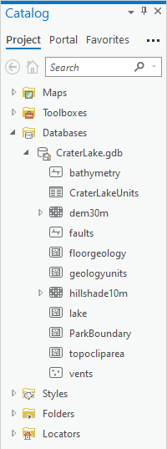
Recap: Feature Class Data Types
Vector Data
Raster Data
“The pixelly stuff”
Imagery
Elevation models
Temperature maps
Composed of cells (squares)
Point
A point location of a city
A single coordinate (latitude, longitude)
Line
Roads
Hiking trails
Streams
Polygon
Countries, states, counties
Lakes, park boundaries

Slide 5

Examples: Feature Class Data Types
Vector Data (Types)
Raster Data (Examples)
Point
Line
College Station
Polygon

Slide 6
Vector Data: Points, Lines, Polygons
Uses x-y location series
Multipart features: Several objects in one feature
e.g., Hawaiian Islands = Hawaii
Vector models:
Spaghetti: features are independent of each other
Topological: features are spatially related
Storing vector data:
Coverage
Separate shapefile (spaghetti; really about 7 different files)
Geodatabase (personal or file geodatabase; .gdb)
Don’t have a resolution.

Slide 7

Raster Data
Size
Columns
Represented in cells (pixels)
Rows and columns determine location of a cell
Data held in a “band”
One band = one “layer” of data within the raster
Have a fixed resolution
Some examples:
Satellite image, aerial photograph
Digital elevation model (DEM)
ESRI basemap
Scanned map
Climate: precipitation, temperature
Rows
Size: 595*868
Resolution: 150 dpi

Slide 8

Raster Resampling
Changing the cell size of a raster
Upsampling: pixels get smaller
Downsampling: pixels get bigger
Four types:
Nearest neighbor
Area-weighted
Bilinear
Cubic convolution
https://www.youtube.com/watch?v=WwnI0RS6J5A

Slide 9
What is the Area of a Pixel?
Raster resolution = ## meters
Look at the raster resolution (it’s in the metadata)!
Resolution is a linear unit of one pixel, not an area

Slide 10
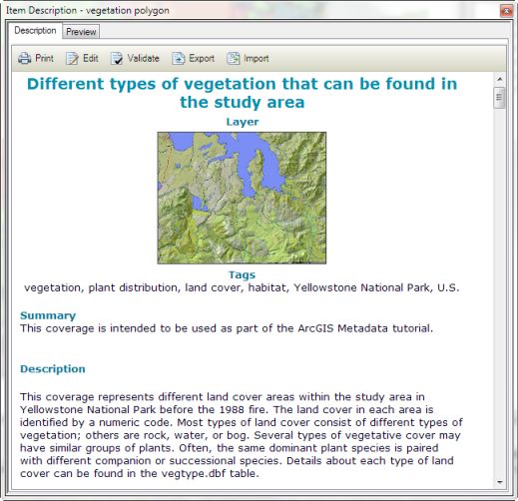
Metadata
“Data about data”
From ESRI:
When care is taken to provide good descriptions, you can find appropriate items with a search and evaluate which of the items in your search results is the correct one to use.
In an item's metadata you can record whatever information is important for your organization to know about that item. This might include information about how accurate and recent the item is, restrictions associated with using and sharing the item, important processes in its life cycle such as generalizing features, and so on.

Slide 11
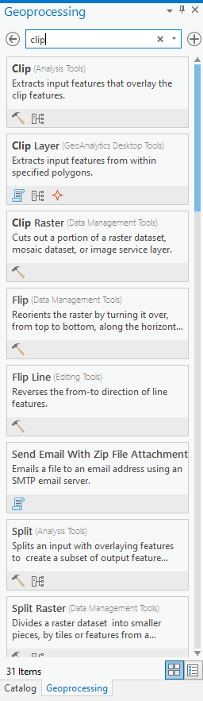
Clip Tools
Vector
There are two (or three):
One to handle vector data: Clip (Analysis Tools)
One to handle raster data (Clip Raster (Data Management Tools)
Extract by Mask*
Raster

Slide 12
Steps 38-39 Workaround (#6)
Create a layer out of climatestations2005 table:
Add climatestations2005, right-click on the layer
Display XY Data → Make XY Event Layer
X Field = long_ Y Field = lat
Layer Name = climatestations2005_Layer
Spatial Reference = GCS_North_American_1983
Run
Select climate stations ONLY in New Jersey
Click on climatestations2005_Layer
Map ribbon → Selection ribbon → Select by Attributes (climatestations2005_Layer)
New Selection type
Clause: state is equal to NJ

Slide 13
Steps 38-39 Workaround (#6)
Check to make sure that 12 stations are selected (only in the state of New Jersey) – open its table to see
Create a new layer out of this selection
Right-click on climatestations2005_Layer
Data → Export Features
Input Features = climatestations2005_Layer
Output Feature Class = njclimatestations
Run
Remove climatestations2005 and climatestations2005_layer from Contents Pane, but KEEP njclimatestations

Slide 14
Tips and Turn-In
Reminder: Don’t use spaces – use underscores ( _ )
“Captioned screenshot”?
Come up with a brief 1-2 sentence description of the figure – what the colors mean, what it shows, etc.
Due next week
Tuesday section (504): Sept. 17
Wednesday section (505): Sept 18
Friday section (506): Sept 20

